Slide 1

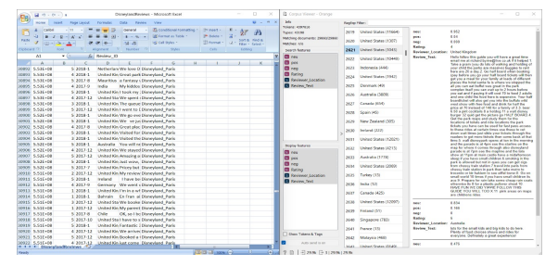
SENTIMENTAL ANALYSIS USING DATA MINING
Department of Computer Science & Engineering
School of Computing
1156CS601 – MINOR PROJECT
WINTER SEMESTER 2022-2023
ABSTRACT
INTRODUCTION
RESULTS
STANDARDS AND POLICIES
Sentiment analysis or opinion mining is a natural language processing (NLP) technique used to determine whether data is positive, negative or neutral. Sentiment analysis is often performed on textual data to help businesses monitor brand and product sentiment in customer feedback, and understand customer needs . Disney world is entertainment place which will be having comments about the rides based on the review it predict .The data mining tool which is going to be used is Orange where python code will run as background.
Social Media Data Mining for Sentiment Analysis is a web based application for college to their student’s posted tweets for Social Media is the use of electronic and Internet tools for the purpose of sharing and discussing information and experiences with other human beings in more efficient ways. Social website like Twitter, WhatsApp and Facebook etc.
Several Researchers carried out research work in Social Network Analysis and sentiment analysis. Sentiment analysis is a text processing technique to derive an opinion or mood intention based on the terms used in a real language sentence. The numbers of researchers have concentrated on generating statistical inference from social network data using sentiment analysis models.
This project is .social economic based project Both consumers and ,sellers will be benefited through this project. Consumers won't waste and invest their money on faulty products. Sel!i'1'S will improve their quality of their services and c.an gain the faith in the consumers. Jn this project - "Sentimental Analysis using Data Mining", we can analyze the review and ratings of a product, books. movies. business. OTT platforms, business etc., We have used "'Orange Data Mining" tool in this project. We can easily understand the analysis by the text processing using Data Mining and python . The outcomes of the project is beneficial to the customers and owners. Customers won't waste their money on the wrong products and business owners can improve their sen1ices in a better way.
Orange Data Mining Tool: Orange is a C++ core object and routines library that include a huge method of standard and non-standard machine learning and data mining algorithms. It is an open-source data visualization, data mining, and machine learning tool. In Orange, it is a scriptable setting for fast prototyping of the current algorithms and testing designs. It is a set of python-based modules that lie in the center library. It execute some functionalities for which performance time is not important, and that is completed in Python. Standard Used: ISO/IEC 27001
.
METHODOLOGIES
MODULE 1: NAVIE BAYES CLASSIFIER Naive bayes classifier is a supervised learning algorithm based on Bayes Theorem with assumption every pair of features are independent. Naive Bayes classifiers assume that each feature contributes independently irrespective of co-relationship between features. For example, a fruit may be considered to be a pen if it is has cap, tip, barrel, end plug regardless of any possible correlations between the cap, tip, barrel, end plug features. First need to calculate posterior probability p(y/x) that is assigning observation to the groups given data i.e. when prior probability p(y) and class conditional probability p(x/y) are known and it checks whether a given observation belongs to a specific target class by means of Bayes theorem.
MODULE 2: LOGICAL REGRESSION Classification is guessing the output from the input variable. However deciding whether element is belonging to particular class is difficult if there is no perfect rule is defined i.e. we need to consider probabilities which means we need to define stochastic model.
CONCLUSIONS
Proposed approach of considering group of friends, followers of a particular user play an important role in finding the political score / activeness as amount of data generating at social media sites like twitter, facebook etc. is huge. This approach gives us a way to precisely concentrating on particular user what social media groups, communities he/she following. Finally comparison between Bernoulli Naive Bayes and Logistic Regression algorithms are show by considering parameter Precision and Recall.
Figure 1. Input and output
TEAM MEMBER DETAILS
18423/K.VENKATA SAI MANIKANTA
17040/C.HARI NARAYANA RAO
18429/M.GANGA VENKATA NARESH
<Student 1.7993590886>
<Student 2. 9160759063>
<Student 3. 8374773195>
<Student 1.VTU18423@VELTECH.EDU.IN >
<Student 2.VTU17040@VELTECH.EDU.IN >
<Student 3.VTU18429@VELTECH.EDU.IN>
ACKNOWLEDGEMENT
B.ARUNA DEVI,M.E/Assistant professor
+91 8610811828
arunadevib@veltech.edu.in
Figure 2: Work flow diagram.

